Slide 1

Algorithms and Data Structures 2 CS 1501
Spring 2022
Sherif Khattab
ksm73@pitt.edu
(Slides are adapted from Dr. Ramirez’s and Dr. Farnan’s CS1501 slides.)

Slide 2
Announcements
Upcoming deadlines:
Lab 4 due on 2/18
Homework 5 due on 2/21

Slide 3
Previous lecture …
Prefix Searching Problem
Multiple solutions:
DST
RST
multi-way RST

Slide 4
CourseMIRROR Reflections (Interesting)
I found the idea of using an optimal number of bits for digital search trees to be interesting
prefix symbol tables were interesting
I found the prefix searching interesting and how it works with RSTs
All the different tree types! Very interesting
The applications of a radix sort trie and a digital search tree were most interesting today.
I enjoyed learning about Radix Search Tries and how different they are.
Different types of ADTs for searching problems such as DST, RST and large branching tries. Cool to see different ways to populate trees
adding into DSTs and RSTs
How a digital search tree uses only the bits not the values to place nodes

Slide 5
CourseMIRROR Reflections (Confusing)
I’m not sure how the code can store the bits in the path/between the nodes.
Also, is there no key comparison when searching a RST because you just need to check if the correct bit path exists?
why we want to determine that it is prefix problem? We can ignore prefix and keep using RST, DST
Runtime comparisons of the different tree types
the thing that was confusing was radials search tree runtimes
I would like to go over more on the run time of Digital Search Tree operations

Slide 6
Prefix Searching (contd.)
Input:
a (large) dynamic set of data items in the form of
n (key, value) pairs; key is a string from an alphabet of size R
Each key has b bits or w characters (the chars are from the alphabet)
What is the relationship between b and w?
a target string
Output:
0: string is not a prefix of nor equal to any of the keys
1: string is a prefix of at least one key but not equal to any
2: string is not a prefix of any key but is equal to a key
3: string is both a prefix of at least one key and equal to one of the keys

Slide 7
Larger branching factor tries
In our binary-based Radix search trie, we considered one bit at a time
What if we applied the same method to characters in a string?
What would this new structure look like?
Let’s try inserting the following strings into an trie:
she, sells, sea, shells, by, the, sea, shore

Slide 8
Another trie example
b
s
t
y
e
h
h
a
l
e
o
e
l
l
r
s
l
e
s
Notes:
Instead of 1 bit per level, now looking at 8
How do we know where a string ends?
How do we know what keys are in the trie?
How do we store values in the trie?

Slide 9
Analysis
Runtime?
Notes:
Θ(w) where w is the character length of the string
Still constant!
So what do we really gain over RSTs?
For strings, w < b, and overall tree height is reduced

Slide 10
Further analysis
Miss times
Require an average of log_{R}(n) nodes to be examined
Where R is the size of the alphabet being considered
Proof in Proposition H of Section 5.2 of the text
Average # of checks with 2²⁰ keys in an RST?
With 2²⁰ keys in a large branching factor trie, assuming 8-bits at a time?
Notes:
Average # of checks with 2²⁰ keys in an RST?
lg(2²⁰) = 20
With 2²⁰ keys in an R-way trie, assuming 8-bit ASCII?
log₂₅₆(2²⁰) = 2.5

Slide 11
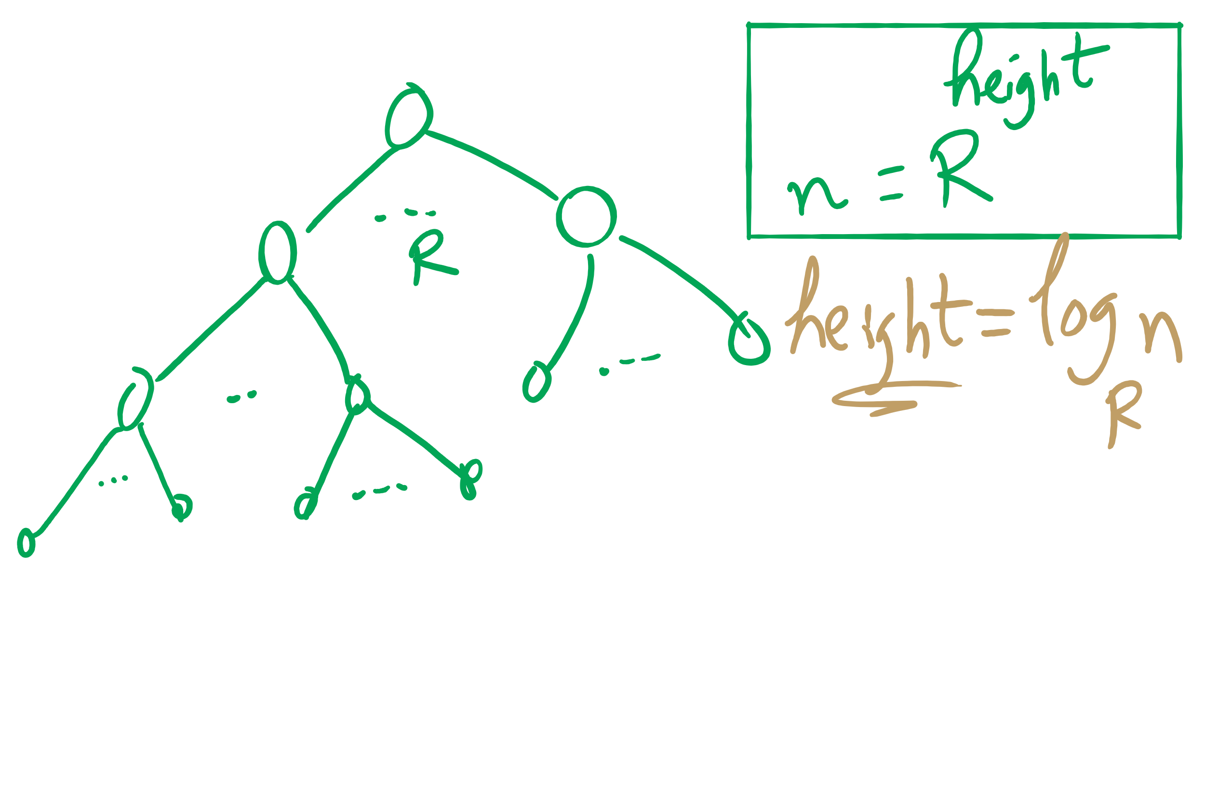
Search Miss

Slide 12
Implementation Concerns
See TrieSt.java
Implements an R-way trie
Basic node object:
private static class Node { private Object val; private Node[] next = new Node[R]; }
Where R is the branching factor
Non-null val means we have traversed to a valid key
Again, note that keys are not directly stored in the trie at all

Slide 13
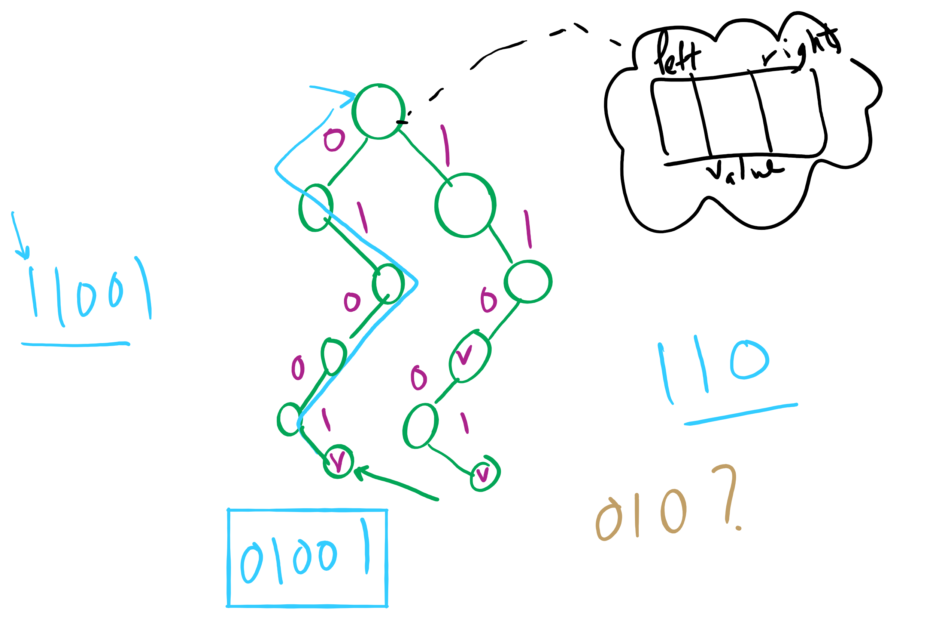
Binary RST

Slide 14
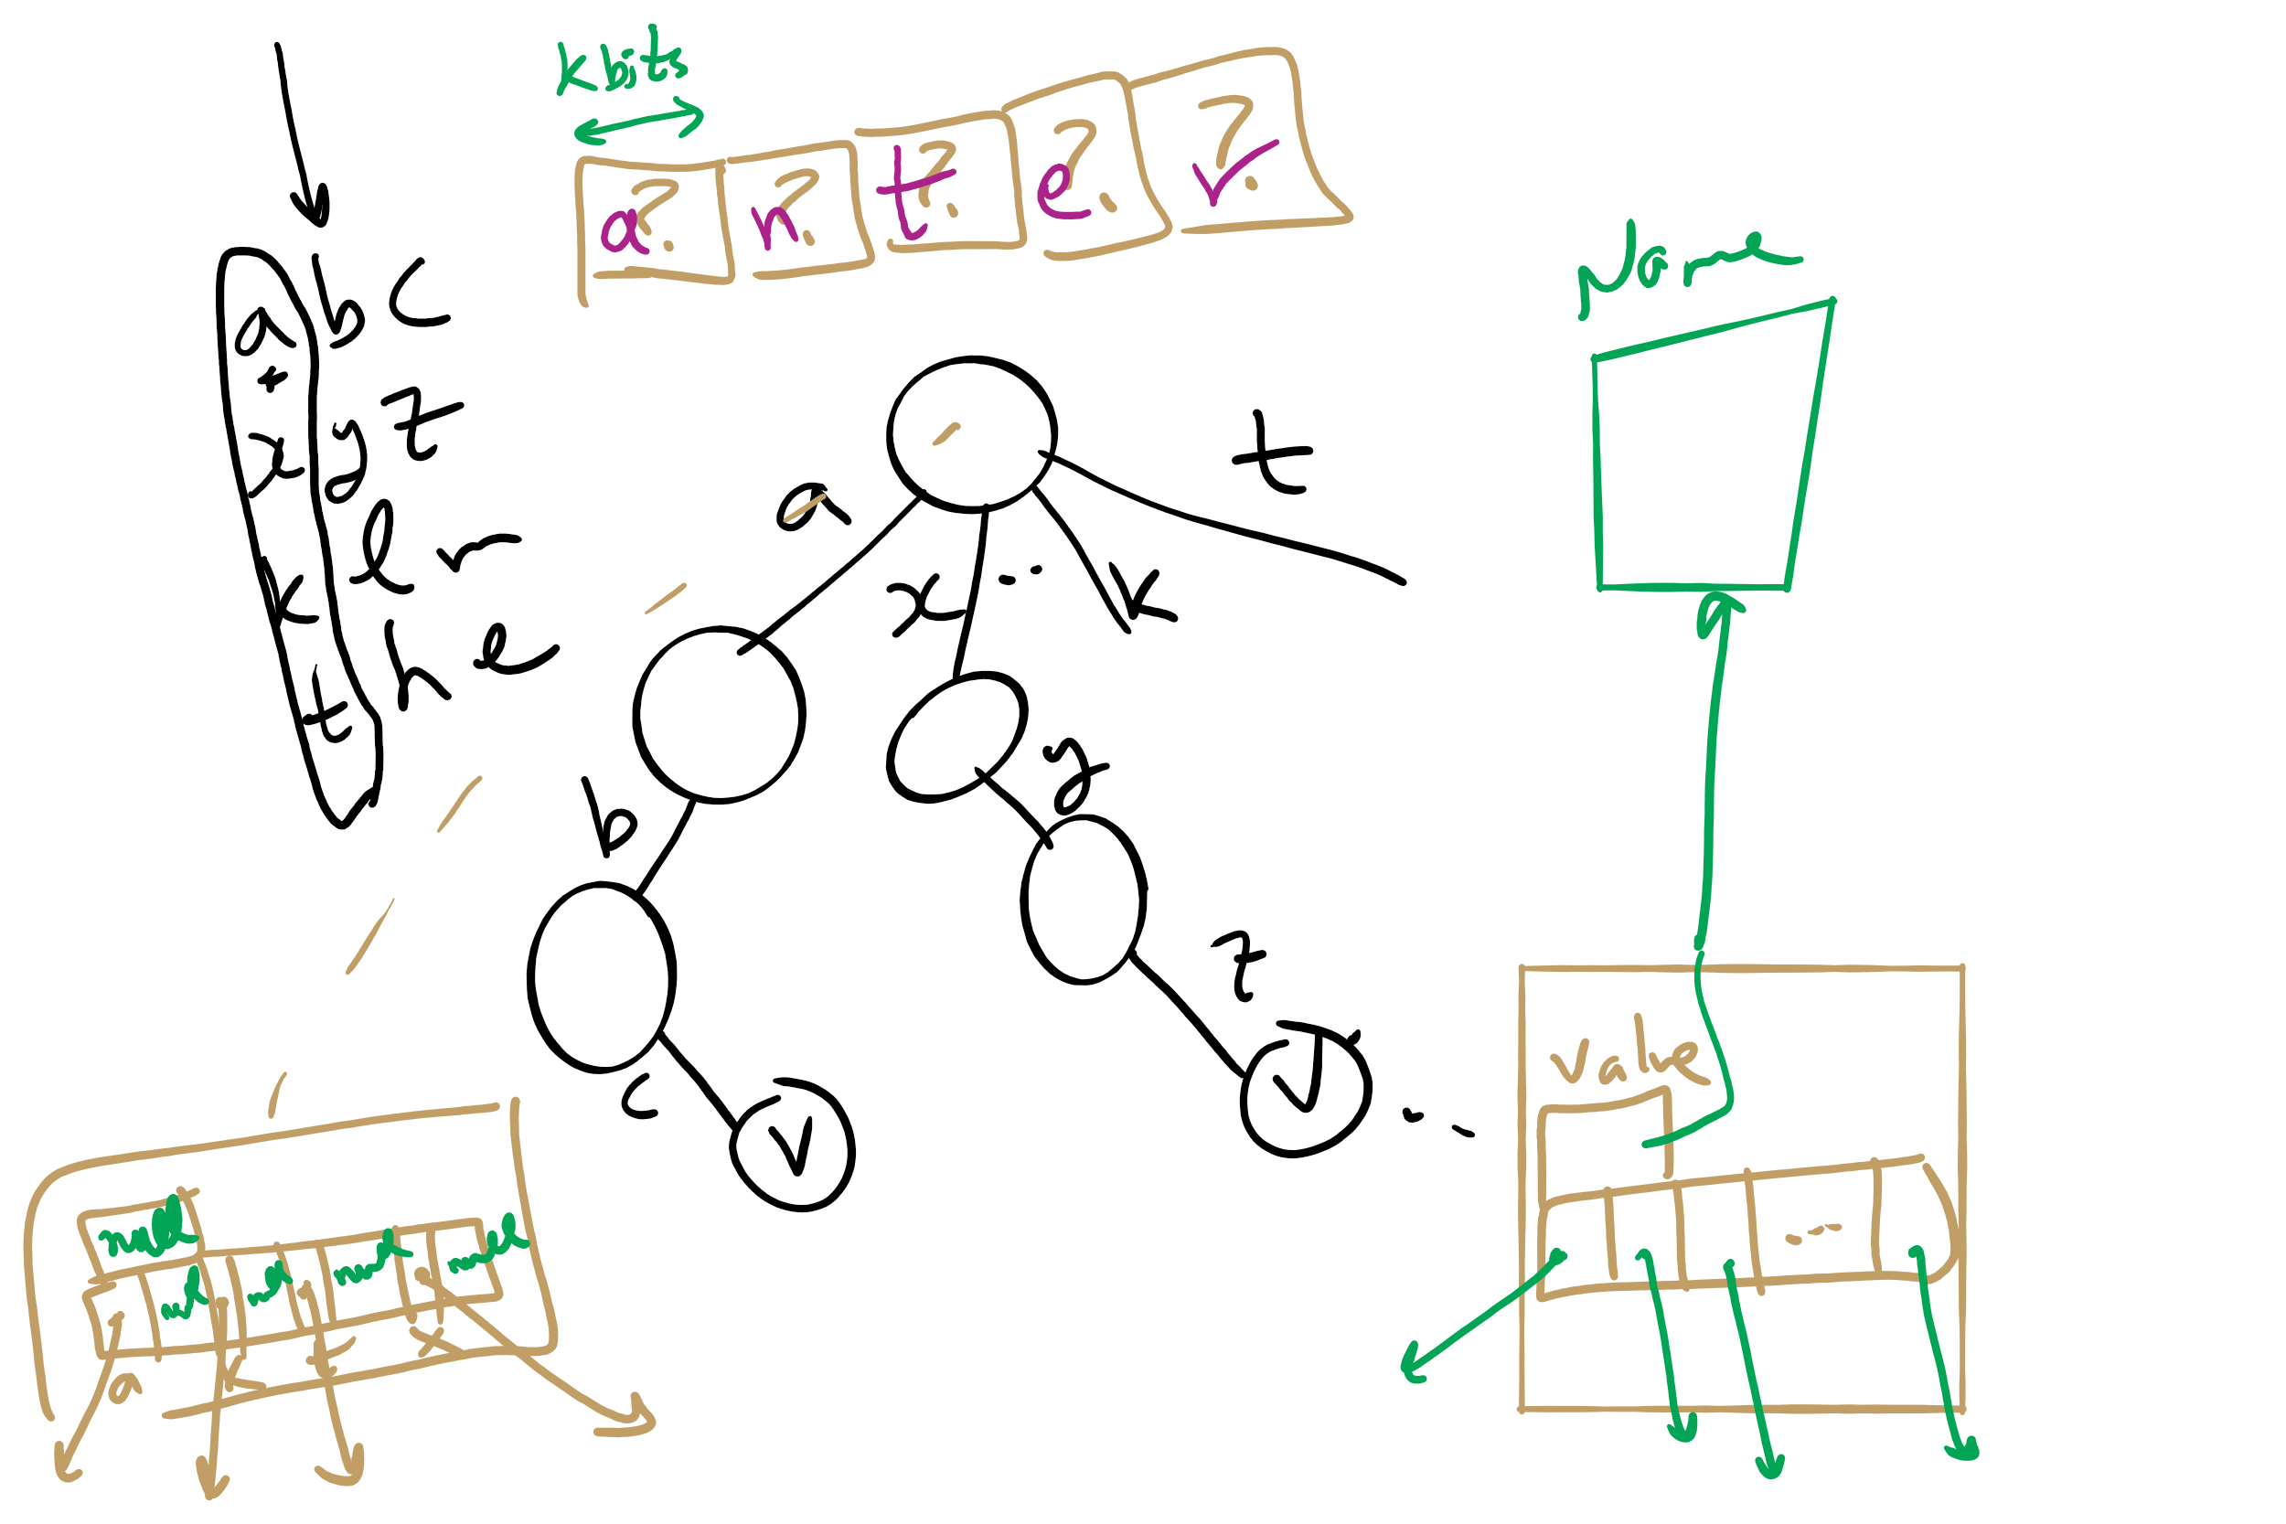
Multi-way RST

Slide 15
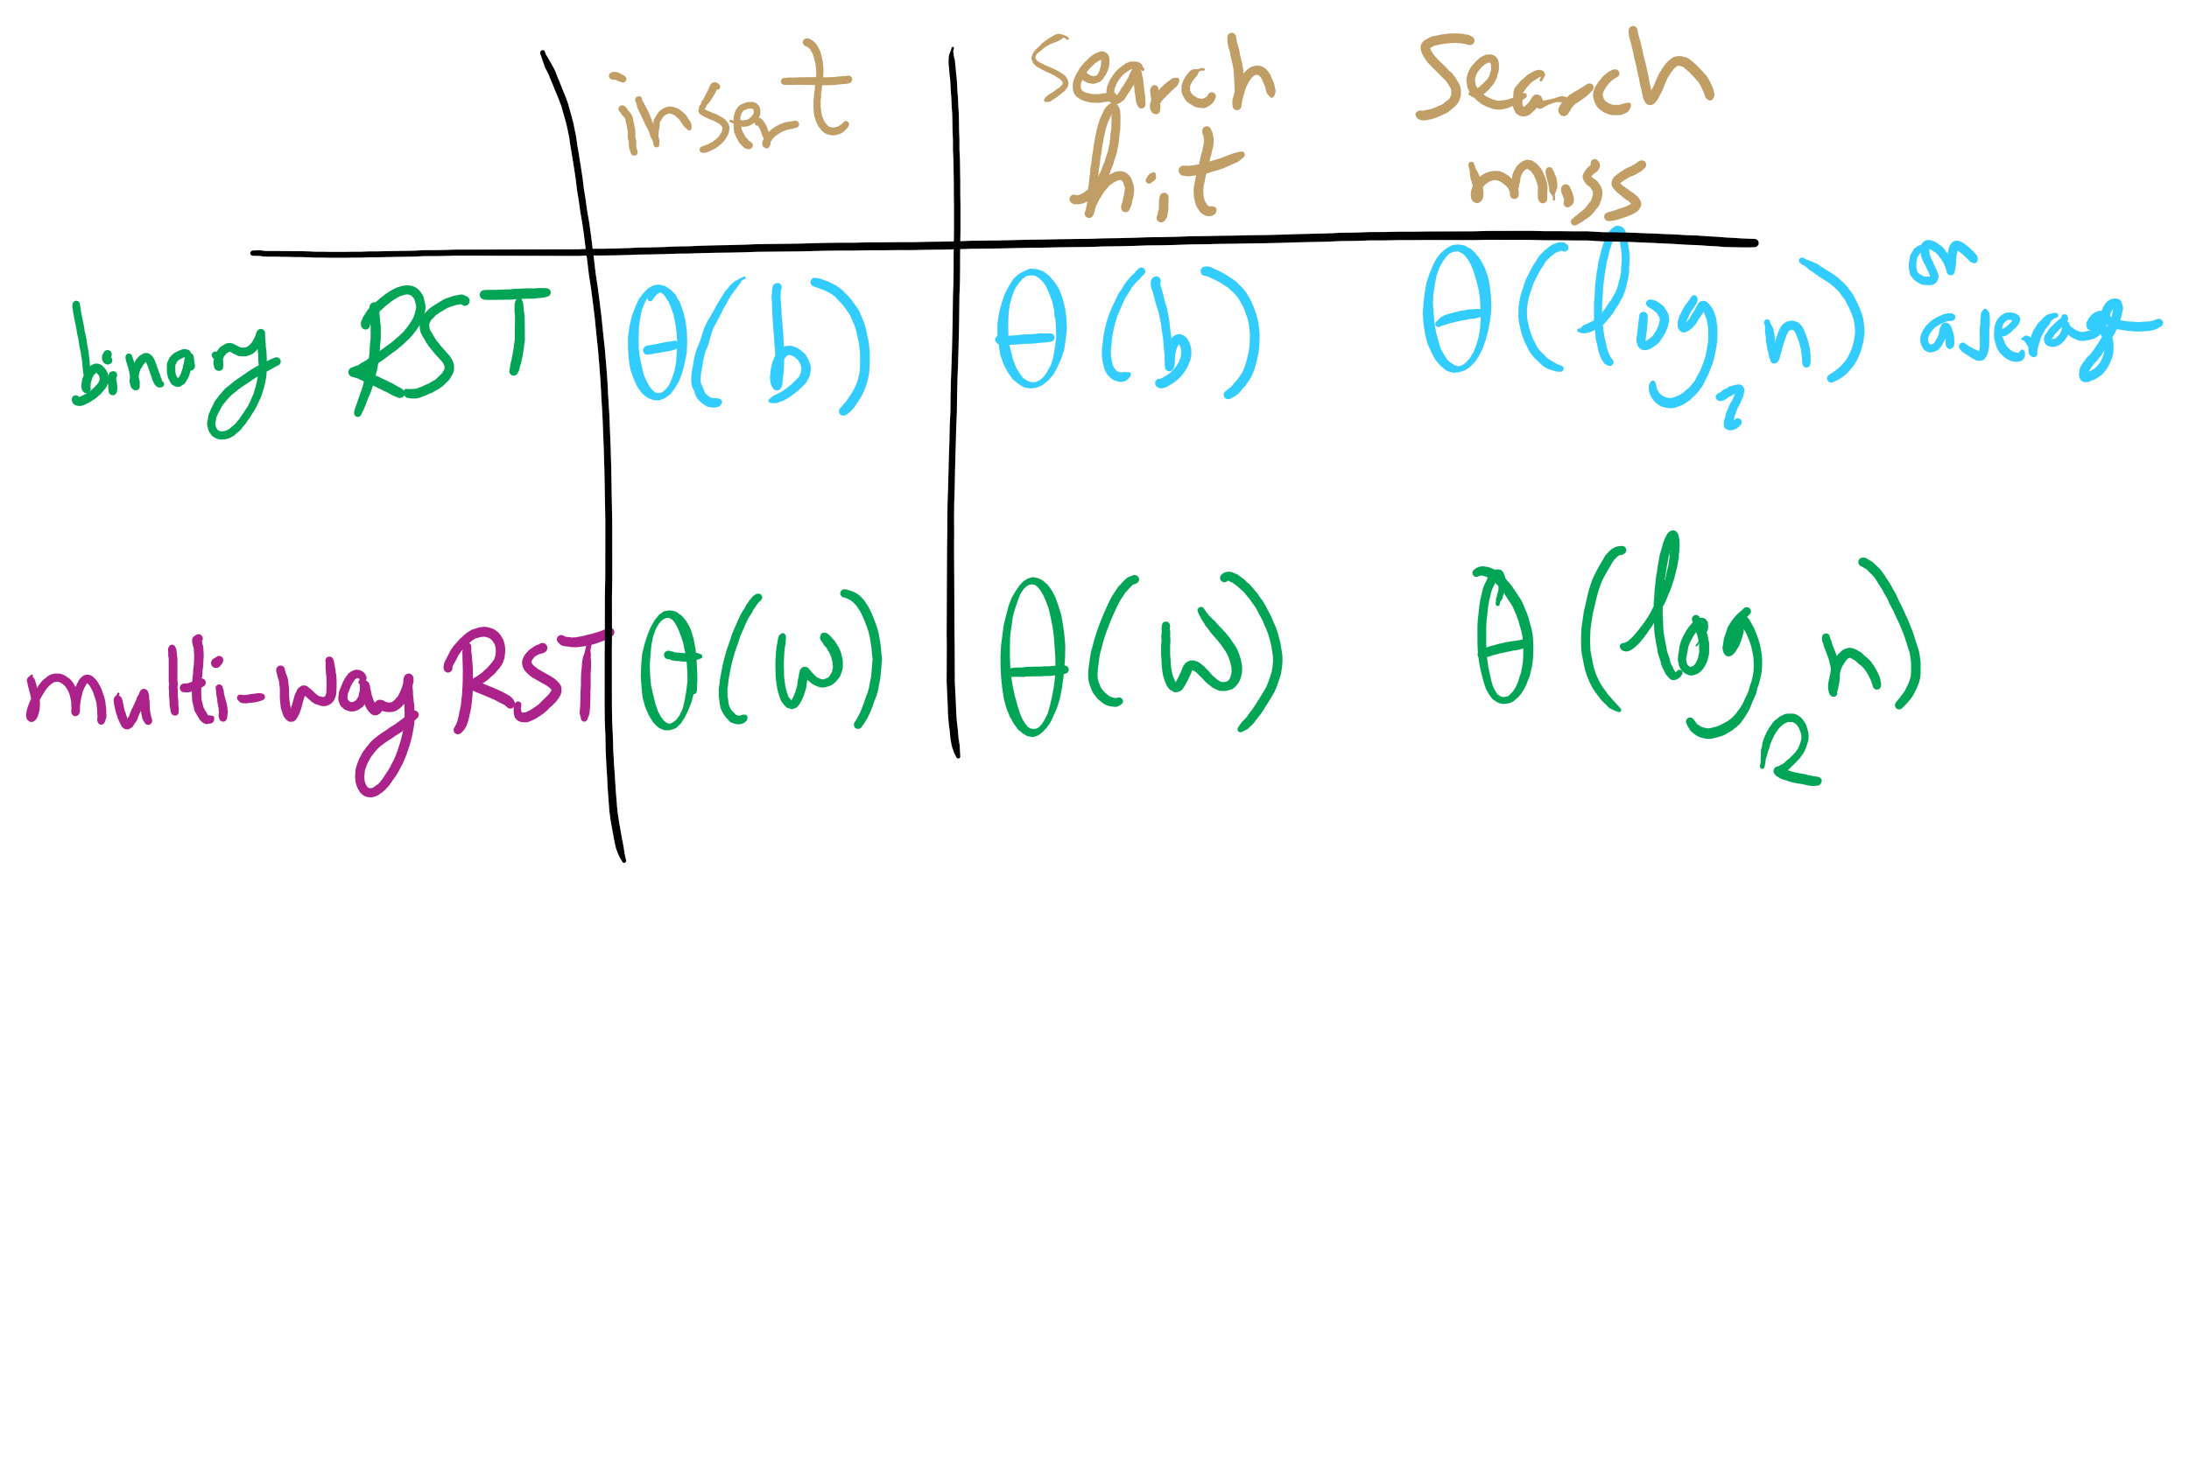
Summary of running time

Slide 16
R-way trie example
Val:
Next
A
B
C
D
E
F
G
H
I
J
K
L
M
N
O
P
Q
R
S
T
U
V
W
X
Y
Z
Val:
Next
A
B
C
D
E
F
G
H
I
J
K
L
M
N
O
P
Q
R
S
T
U
V
W
X
Y
Z
Val:
Next
A
B
C
D
E
F
G
H
I
J
K
L
M
N
O
P
Q
R
S
T
U
V
W
X
Y
Z
Val:
0
Next
A
B
C
D
E
F
G
H
I
J
K
L
M
N
O
P
Q
R
S
T
U
V
W
X
Y
Z
Val:
Next
A
B
C
D
E
F
G
H
I
J
K
L
M
N
O
P
Q
R
S
T
U
V
W
X
Y
Z
Val:
1
Next
A
B
C
D
E
F
G
H
I
J
K
L
M
N
O
P
Q
R
S
T
U
V
W
X
Y
Z

Slide 17
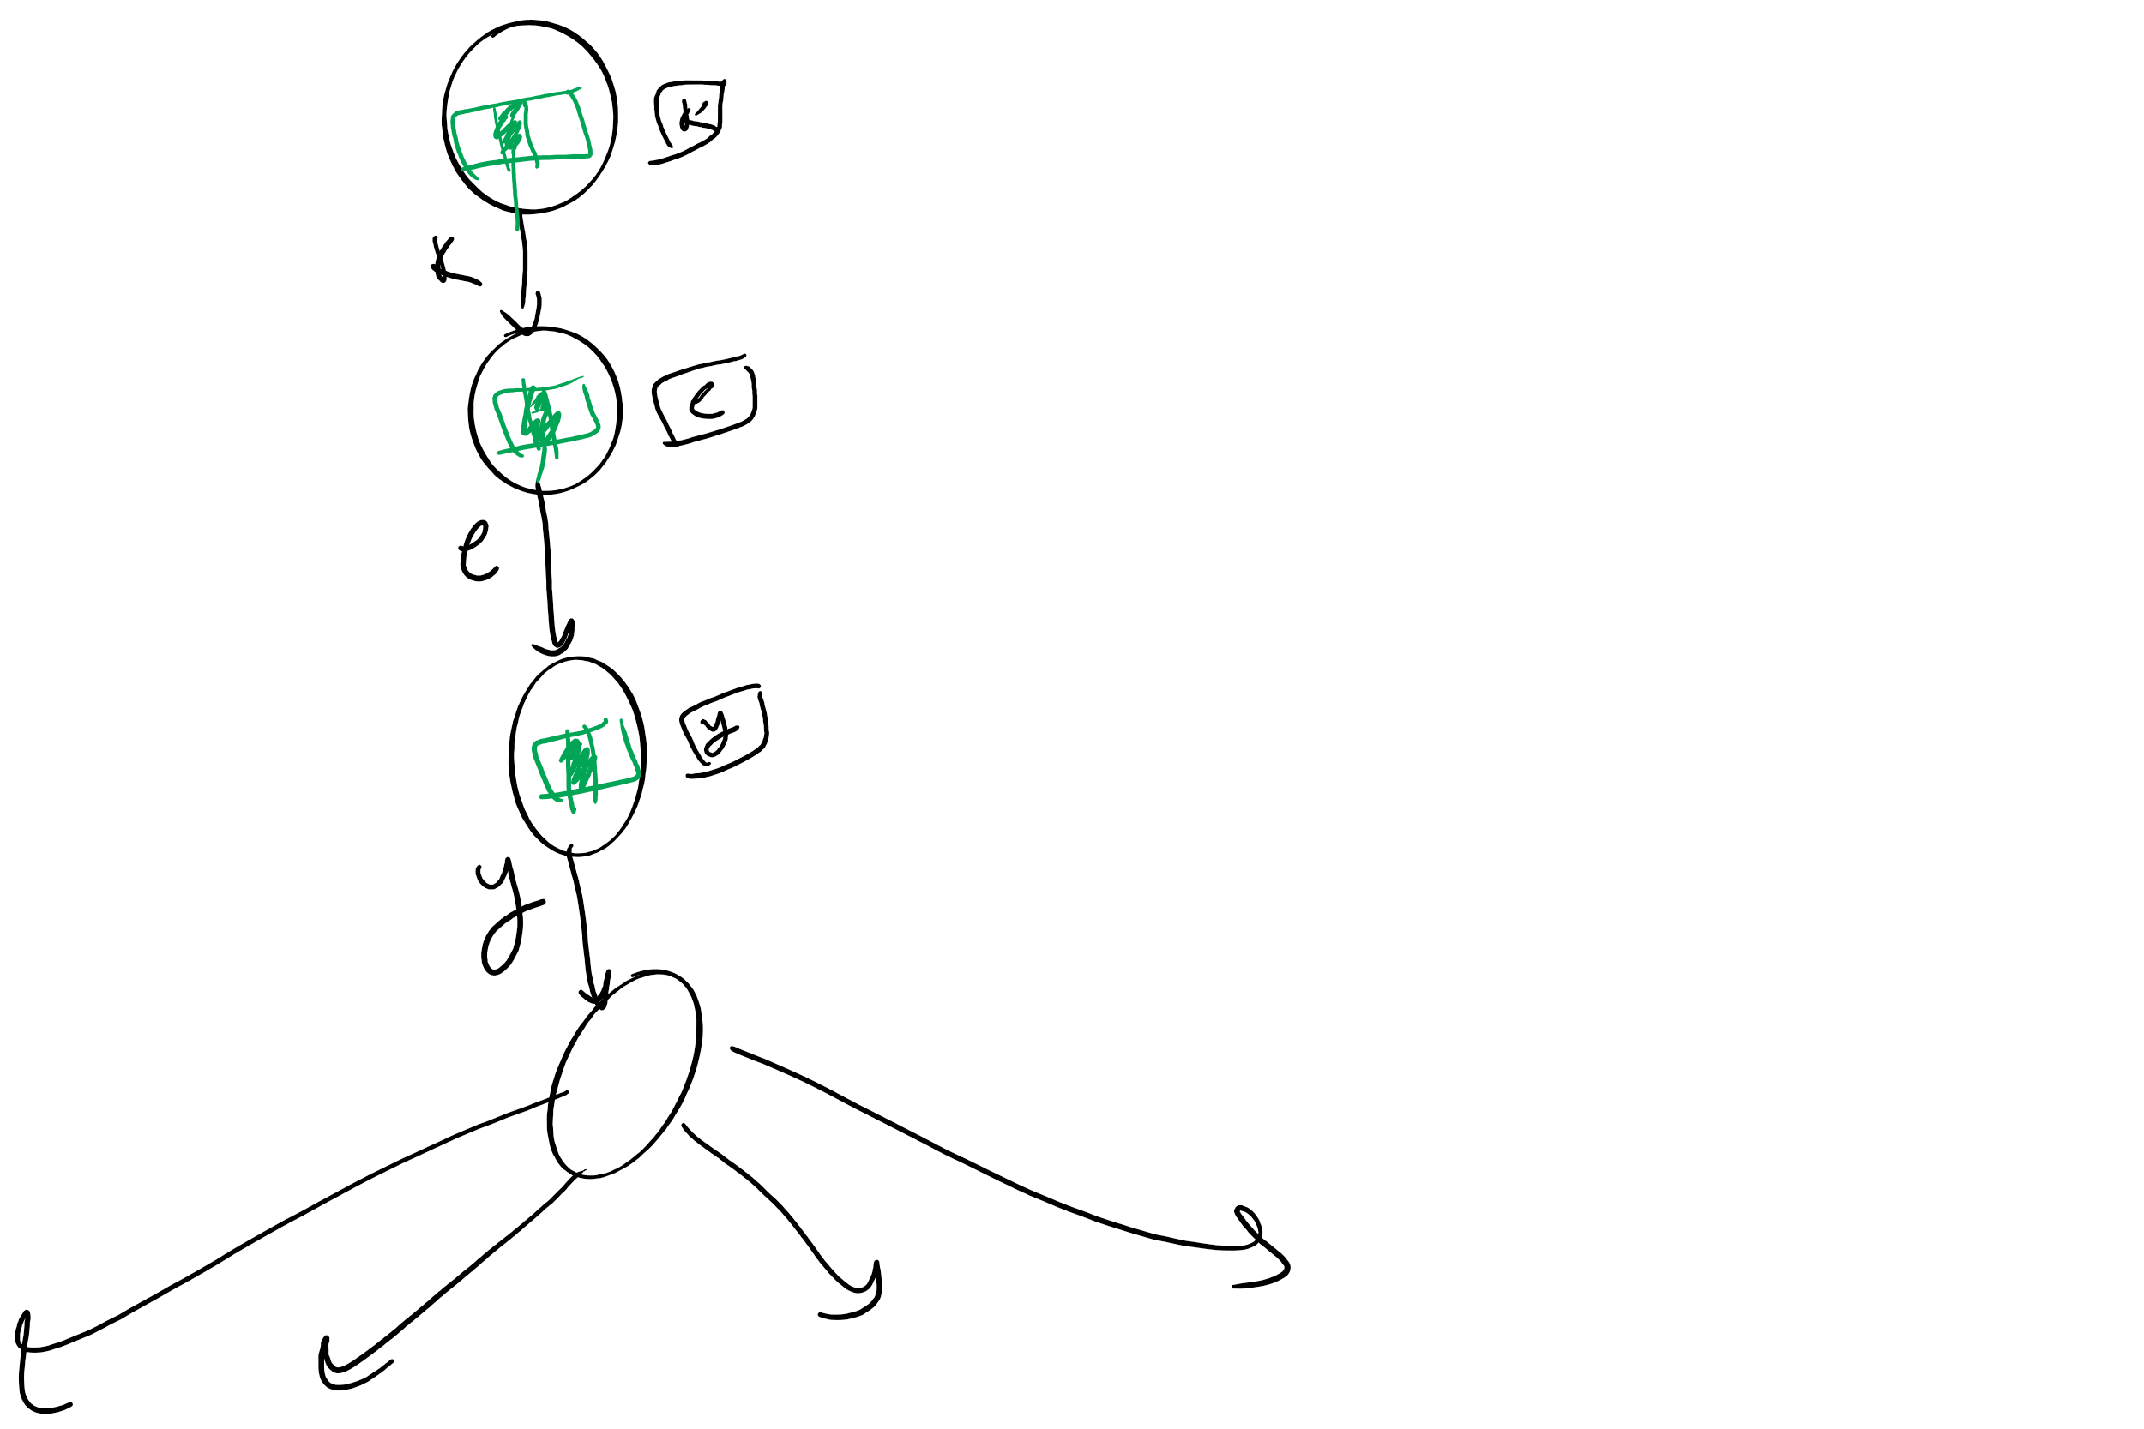
So what’s the catch?
Space!
Considering 8-bit ASCII, each node contains 2⁸ references!
This is especially problematic as in many cases, alot of this space is wasted
Common paths or prefixes for example, e.g., if all keys begin with “key”, thats 255*3 wasted references!
At the lower levels of the trie, most keys have probably been separated out and reference lists will be sparse

Slide 18
De La Briandais tries (DLBs)
Replace the .next array of the R-way trie with a linked-list

Slide 19
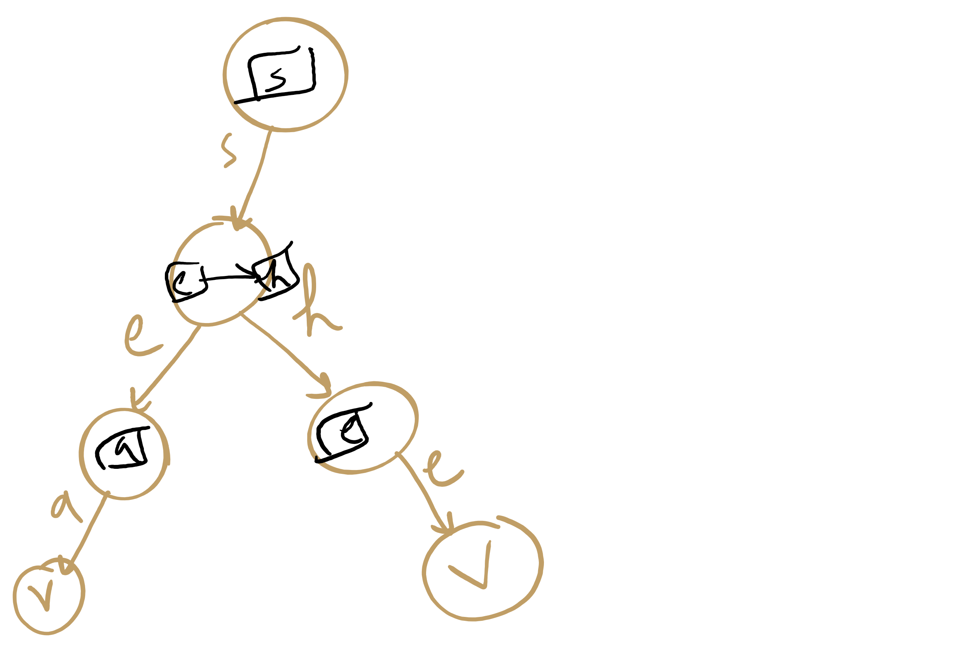
DLB Example

Slide 20
DLB Example 2: nodes vs. nodelets
S
B
T
H
E
Y
H
E
L
A
^
E
^
L
L
^
^
L
S
S
^
^
Notes:
note here we use explicit termination character vs value check, can do either though

Slide 21
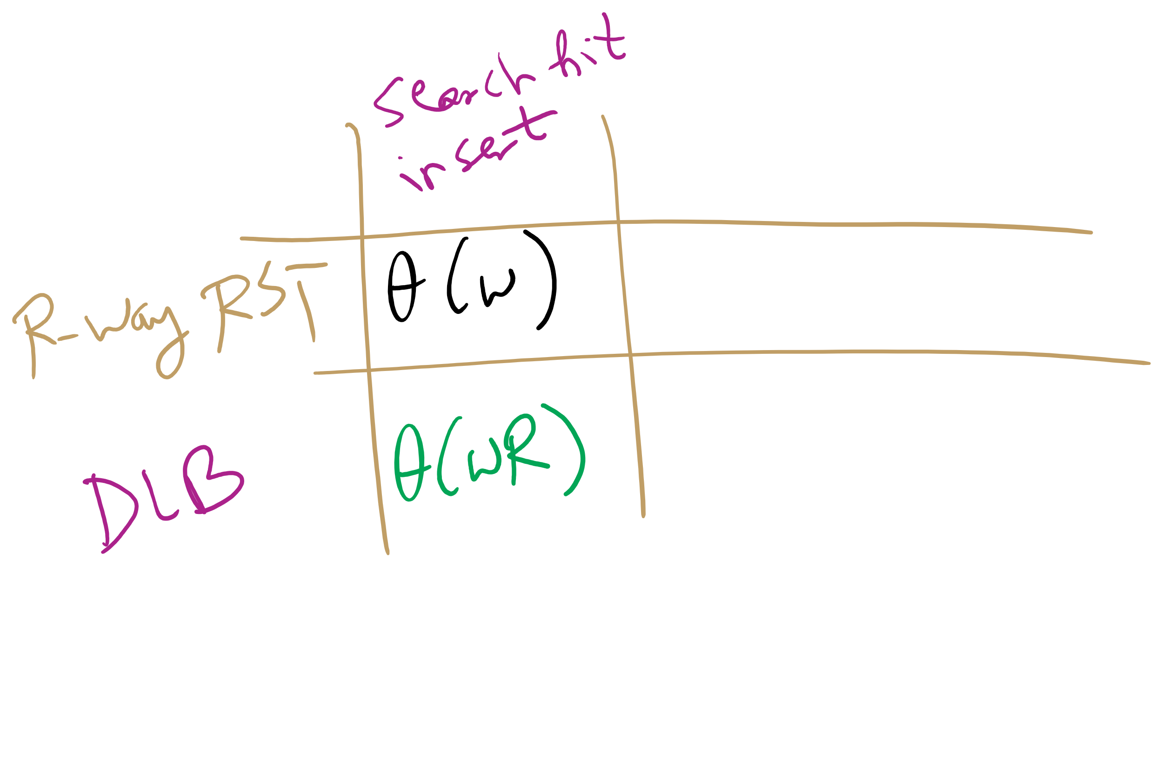
DLB analysis
How does DLB performance differ from R-way tries?
Which should you use?
Notes:
Differences:
No wasted space!
But search/insert are now Θ(wR)
In the worst case, we have to iterate through all R characters in the alphabet for each node
When to use one over another?
For implementations with alot of sparse nodes are expected, use a DLB
Runtime will still be close to Θ(w) for sparse nodes
For dense nodes, stick with R-way tries
If most of the alphabet is a valid reference for most nodes, you won’t get a whole lot of space savings with DLBs

Slide 22
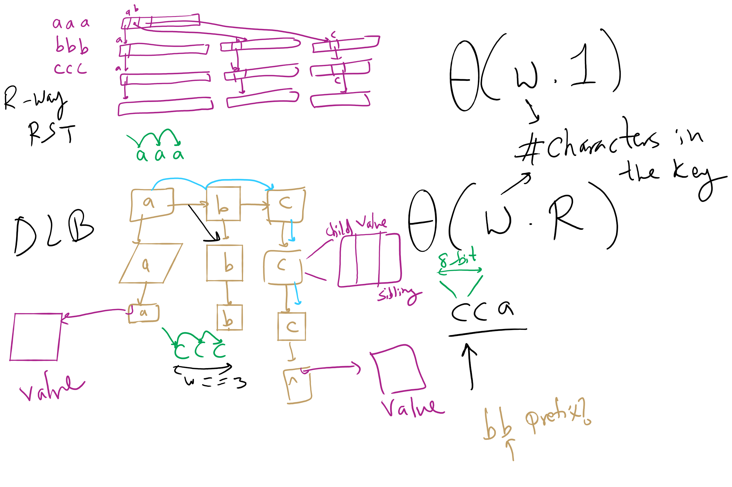
R-way RST vs. DLB

Slide 23
Let’s go back to our Prefix Symbol Table an ADT!
The Prefix Symbol Table ADT
A set of (key, value) pairs
Operations of the PST ADT
insert
delete
prefixSearch
search
How can we implement prefixSearch?

Slide 24
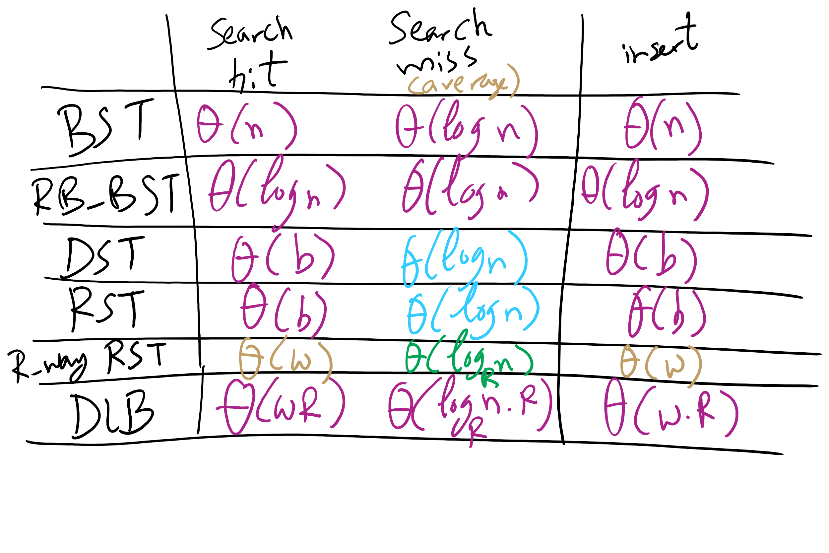
Runtime Comparison for Search Trees/Tries

Slide 25
Final notes on Search Tree/Tries
We did not present an exhaustive look at search trees/tries, just the sampling that we’re going to focus on
Many variations on these techniques exist and perform quite well in different circumstances
Ternary search Tries
R-way tries without 1-way branching
See the table at the end of Section 5.2 of the text

Slide 26
Problem of the Day: Compression
Input: A sequence of characters
n characters
each encoded as an 8-bit Extended ASCII
Output: A bit string
of length less than 8*n
the original sequence can be fully restored from the bitstring

Slide 27
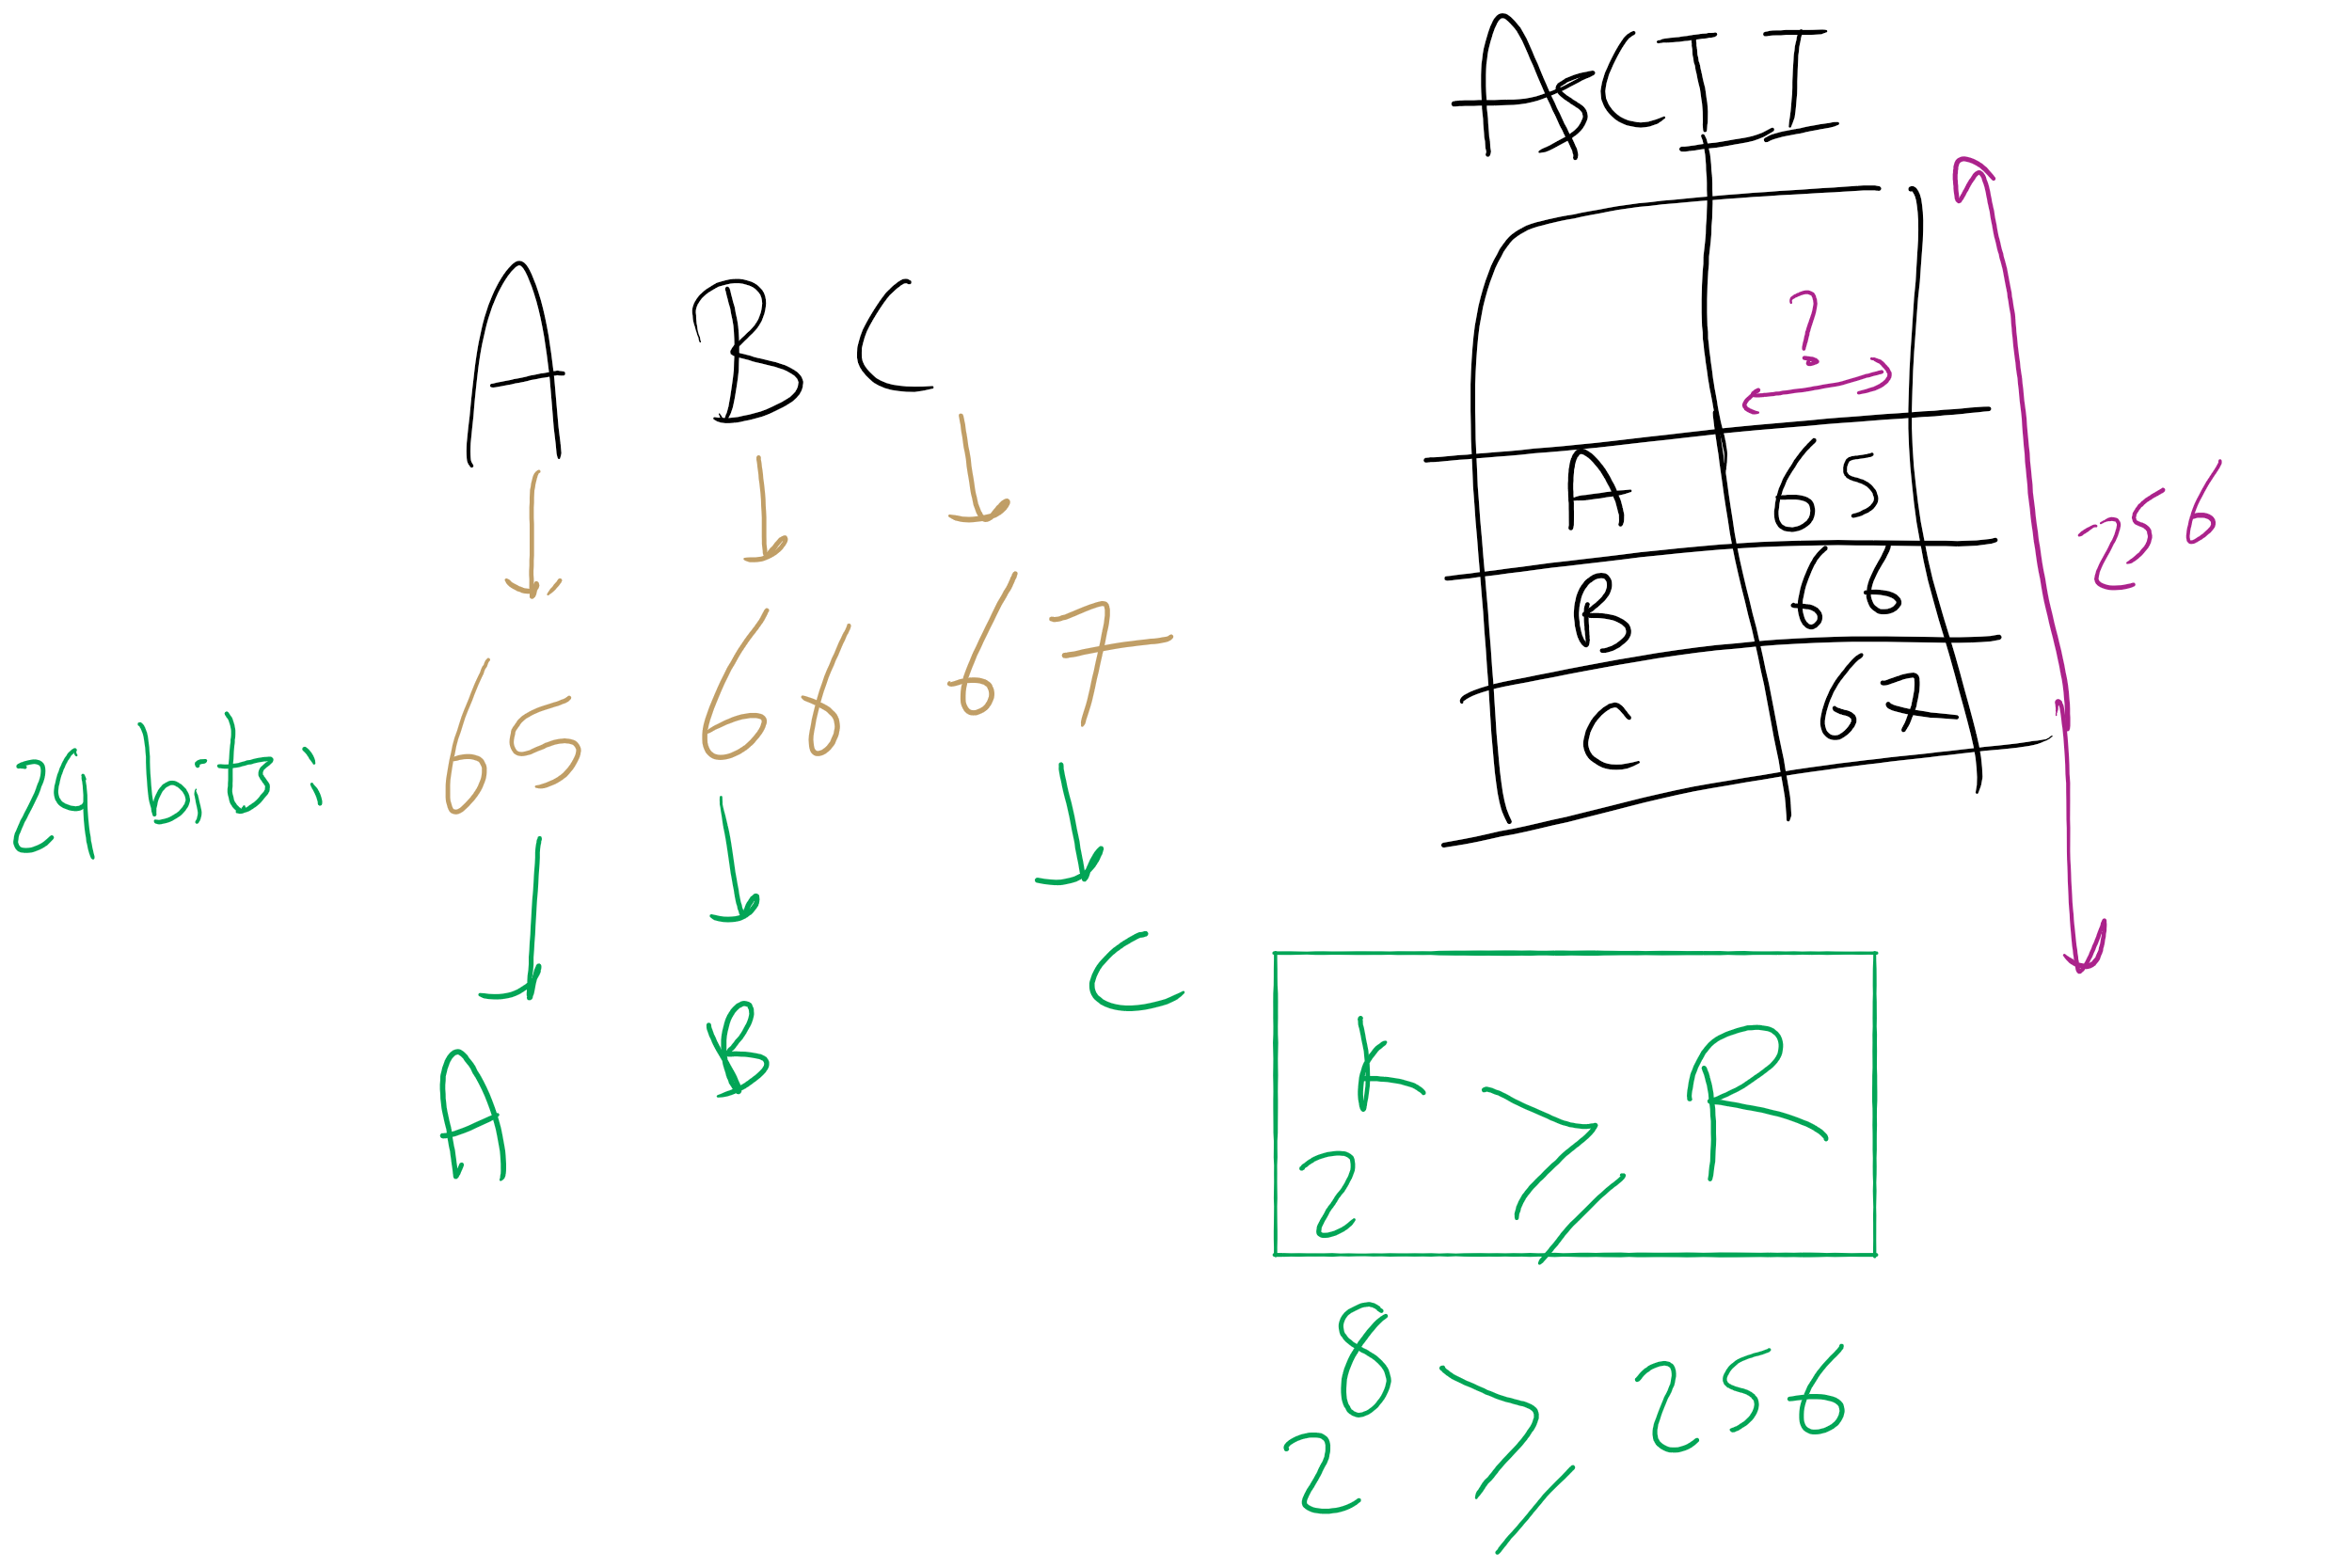
ASCII Encoding

Slide 28
Lossless Compression
D
Compress
C
Expand
D
Input can be recovered from compressed data exactly
Examples:
zip files, FLAC
Notes:
differences? anecdotally, a 600MB cd compresses to ~80MB mp3 and ~250MB flac

Slide 29
Lossy Compression
D
Compress
C
Expand
D’
Information is permanently lost in the compression process
Examples:
MP3, H264, JPEG
With audio/video files this typically isn’t a huge problem as human users might not be able to perceive the difference

Slide 30
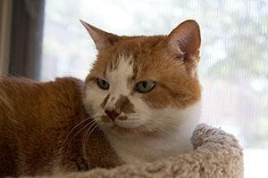

Lossy examples
MP3
“Cuts out” portions of audio that are considered beyond what most people are capable of hearing
JPEG
40K
28K

Slide 31
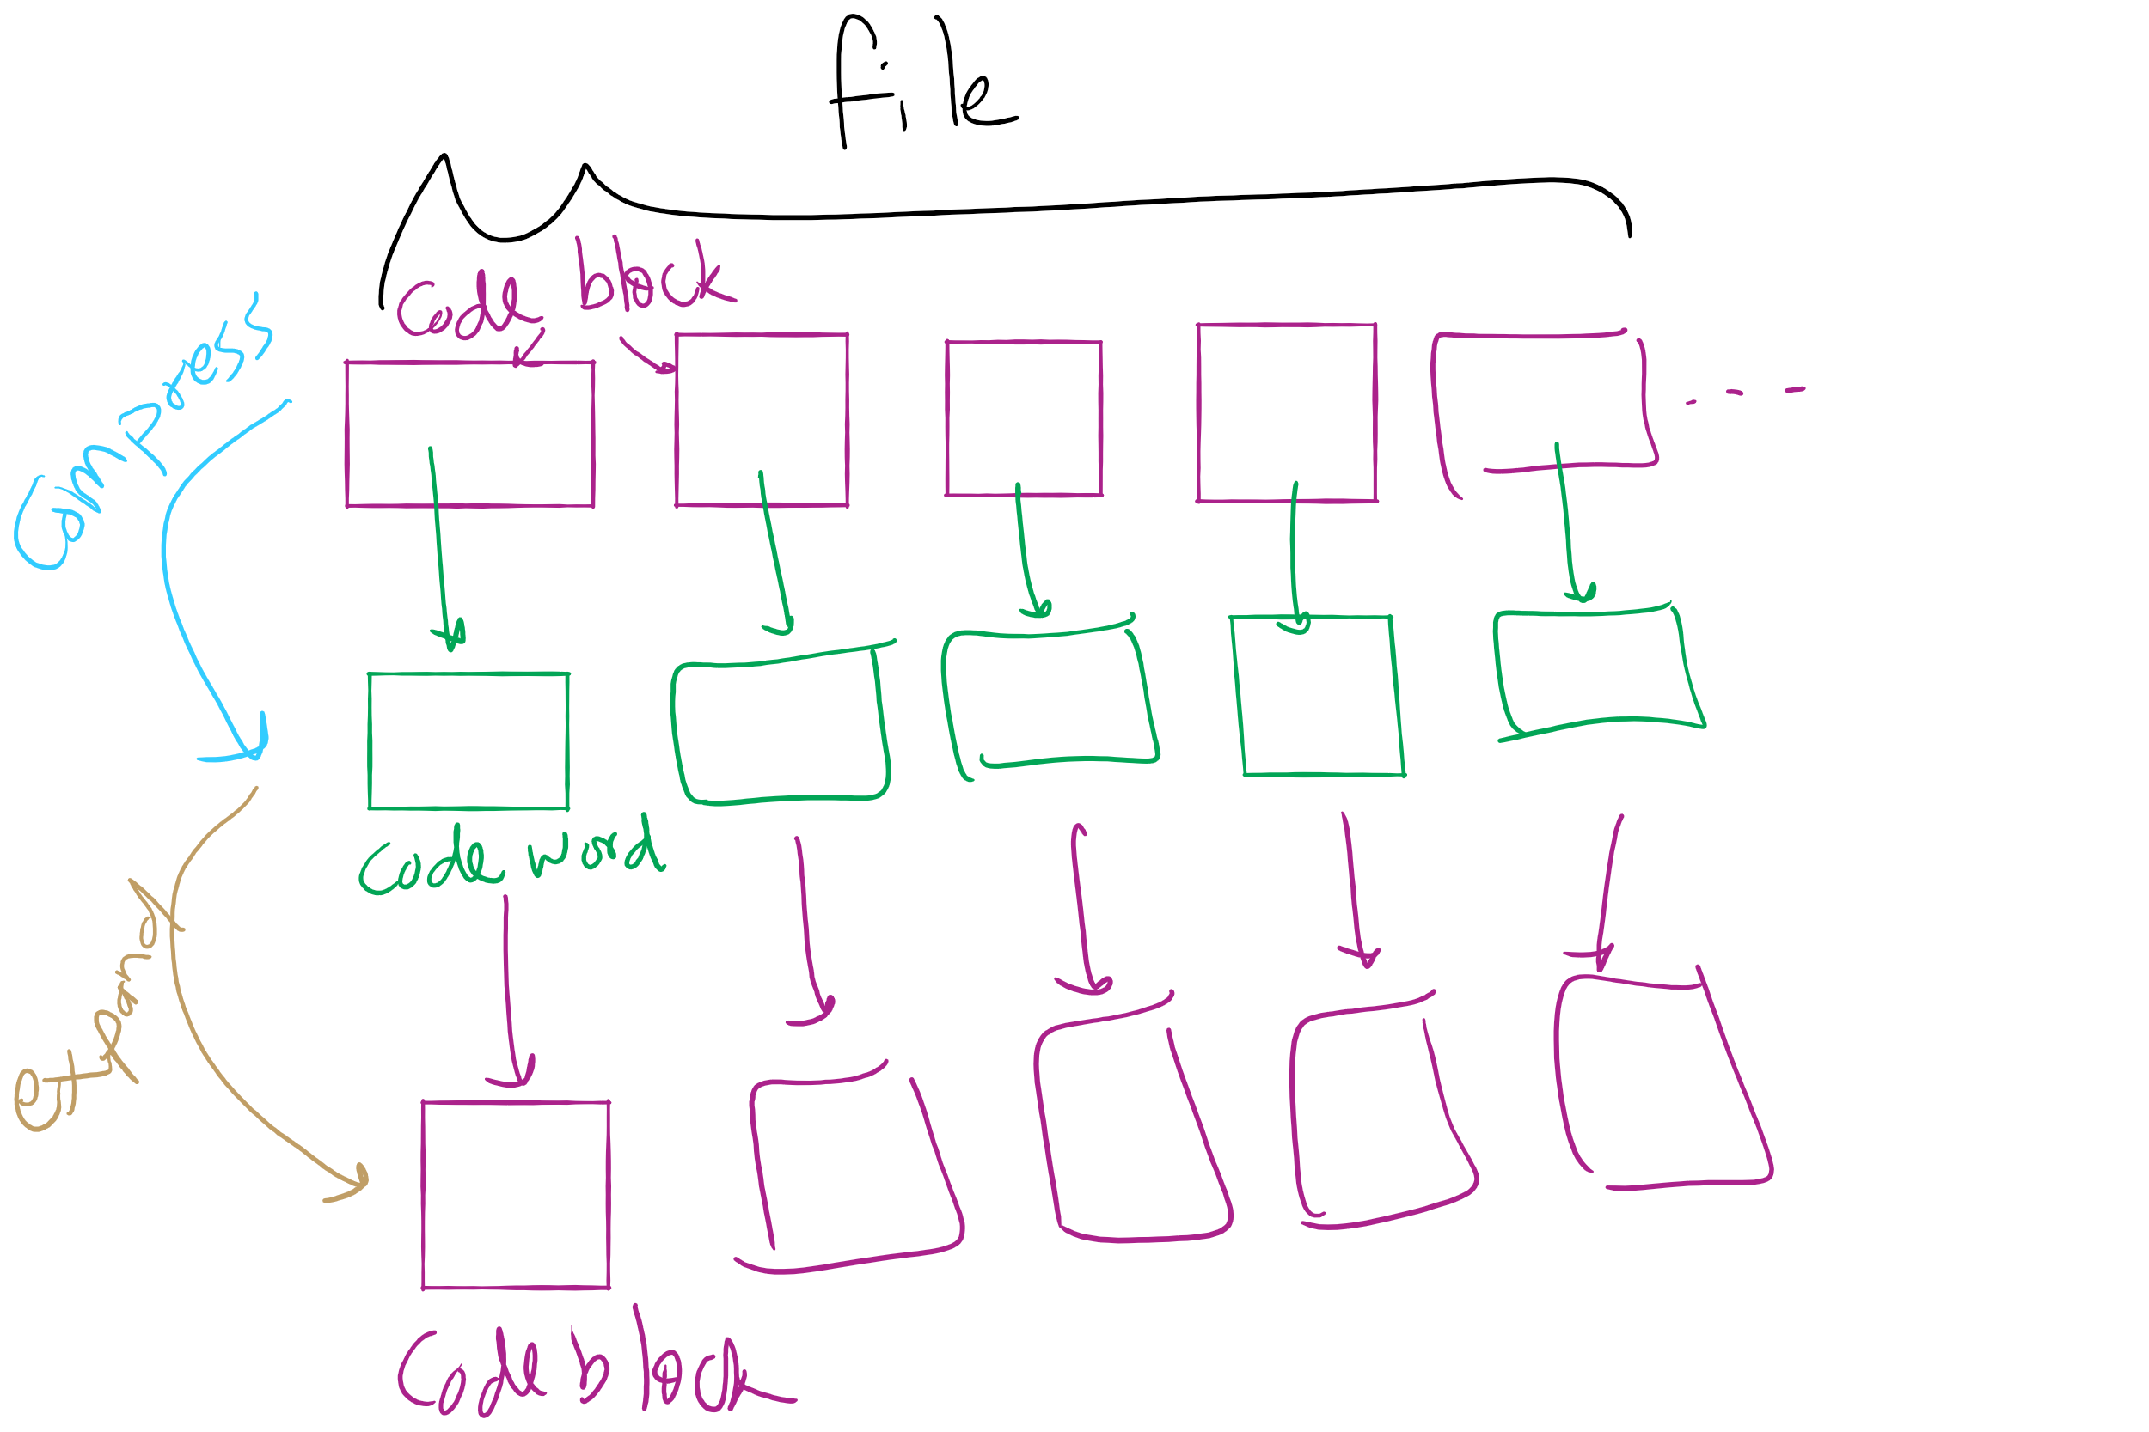
Lossless Compression Framework

Slide 32
Solution 1: Huffman Compression
What if we used variable length codewords instead of the constant 8? Could we store the same info in less space?
Different characters are represented using codes of different bit lengths
If all characters in the alphabet have the same usage frequency, we can’t beat block storage
On a character by character basis…
What about different usage frequencies between characters?
In English, R, S, T, L, N, E are used much more than Q or X

Slide 33
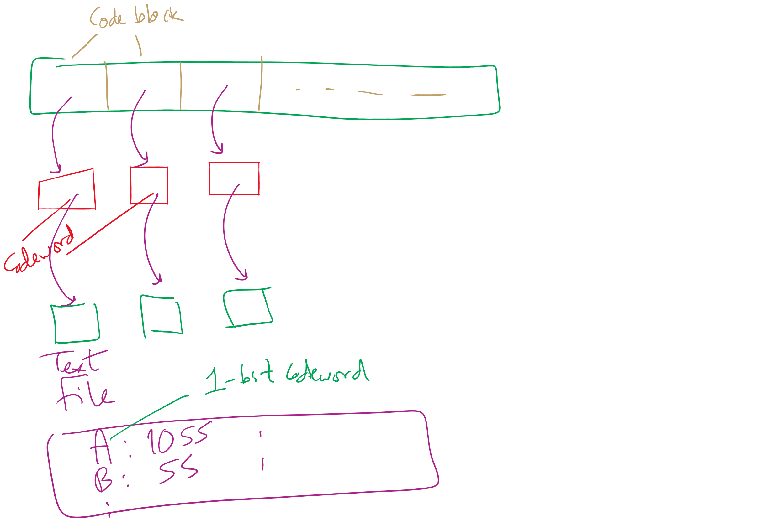
Variable size codewords

Slide 34
But we have to worry about restoring the data!
Decoding was easy for block codes
Grab the next 8 bits in the bitstring
How can we decode a bitstring that is made of variable length code words?
BAD example of variable length encoding:
1
00
01
001
100
101
10101
A
T
K
U
R
C
N
Notes:
delimiters are wasteful
Example on board:
General sends message: 10000110101
Is that: 1, 00, 00, 1, 101, 01 (A, T, T, A, C, K)
or: 100, 001, 10101 (R, U, N)

Slide 35
Variable length encoding for lossless compression
Codes must be prefix free
No code can be a prefix of any other in the scheme
Using this, we can achieve compression by:
Using fewer bits to represent more common characters
Using longer codes to represent less common characters

Slide 36
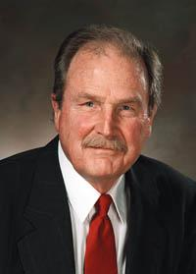
How can we create these prefix-free codes?
Huffman encoding!

Slide 37
Generating Huffman codes
Assume we have K characters that are used in the file to be compressed and each has a weight (its frequency of use)
Create a forest, F, of K single-node trees, one for each character, with the single node storing that char’s weight
while |F| > 1:
Select T1, T2 ∈ F that have the smallest weights in F
Create a new tree node N whose weight is the sum of T1 and T2’s weights
Add T1 and T2 as children (subtrees) of N
Remove T1 and T2 from F
Add the new tree rooted by N to F
Build a tree for “ABRACADABRA!”
Notes:
build tree for abracadabra, use it to construct compressed string,

Slide 38
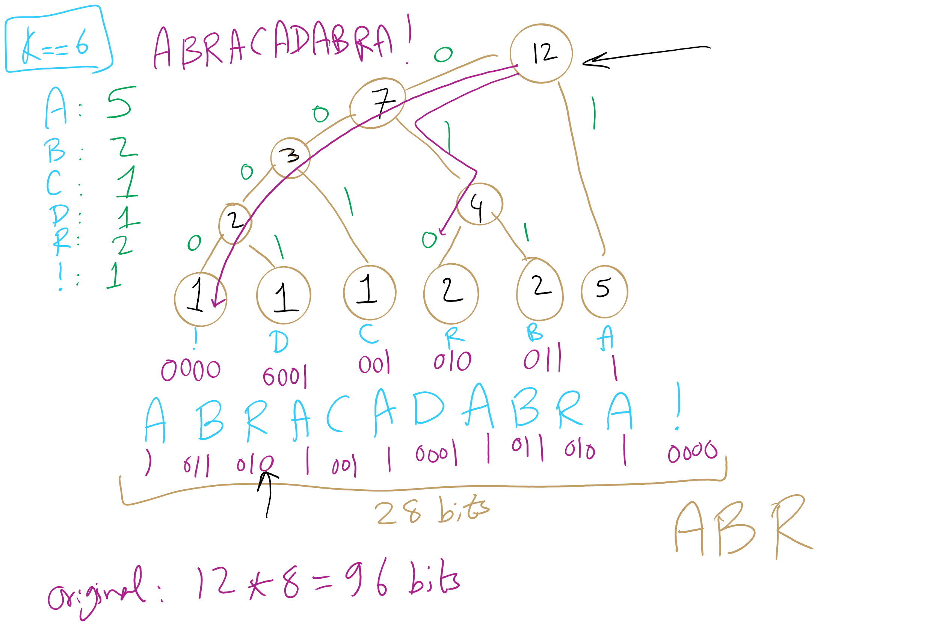
Huffman Tree Construction Example

Slide 39
Implementation concerns
To encode/decode, we'll need to read in characters and output codes/read in codes and output characters
…
Sounds like we'll need a symbol table!
What implementation would be best?
Same for encoding and decoding?
Note that this means we need access to the trie to expand a compressed file!
Notes:
Probably best to create a lookup table for encoding…
Traverse the tree and construct the table
Then you can simply lookup and output the appropriate code for each character in the input string!
Here, we’ll use the trie we constructed earlier
Descend the trie according to the bits of the compressed file
When you hit a leaf, output the appropriate character
Return to the root and repeat…

Slide 40
Further implementation concerns
Need to efficiently be able to select lowest weight trees to merge when constructing the trie
Can accomplish this using a priority queue
Need to be able to read/write bitstrings!
Unless we pick multiples of 8 bits for our codewords, we will need to read/write fractions of bytes for our codewords
We’re not actually going to do I/O on fraction of bytes
We’ll maintain a buffer of bytes and perform bit processing on this buffer
See BinaryStdIn.java and BinaryStdOut.java
Notes:
priority queues will be the subject of a lecture yet to come...

Slide 41
Binary I/O
private static void writeBit(boolean bit) { // add bit to buffer buffer <<= 1; if (bit) buffer |= 1; // if buffer is full (8 bits), write out as a single byte N++; if (N == 8) clearBuffer();
}
writeBit(true);
writeBit(false);
????????
???????0
???????1
??????10
?????100
?????101
????1010
???10100
??101000
?1010000
10100000
10100001
buffer:
00000000
writeBit(true);
writeBit(false);
writeBit(false);
0
1
2
3
4
5
6
7
8
writeBit(false);
N:
0
writeBit(false);
writeBit(true);

Slide 42
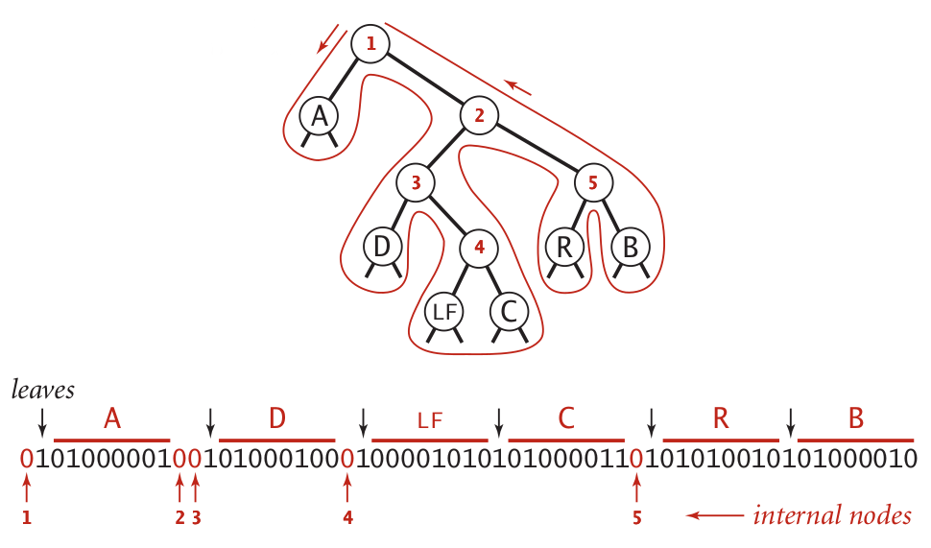
Representing tries as bitstrings

Slide 43
Binary I/O
private static void writeTrie(Node x){
if (x.isLeaf()) {
BinaryStdOut.write(true);
BinaryStdOut.write(x.ch);
return; } BinaryStdOut.write(false);
writeTrie(x.left);
writeTrie(x.right); }
private static Node readTrie() {
if (BinaryStdIn.readBoolean())
return new Node(BinaryStdIn.readChar(), 0, null, null);
return new Node('\0', 0, readTrie(), readTrie());
}
Notes:
tracing through to verify that this code works is left as an exercise to the students

Slide 44
Binary I/O
private static void writeBit(boolean bit) { // add bit to buffer buffer <<= 1; if (bit) buffer |= 1; // if buffer is full (8 bits), write out as a single byte N++; if (N == 8) clearBuffer();
}
writeBit(true);
writeBit(false);
????????
???????0
???????1
??????10
?????100
?????101
????1010
???10100
??101000
?1010000
10100000
10100001
buffer:
00000000
writeBit(true);
writeBit(false);
writeBit(false);
0
1
2
3
4
5
6
7
8
writeBit(false);
N:
0
writeBit(false);
writeBit(true);

Slide 45
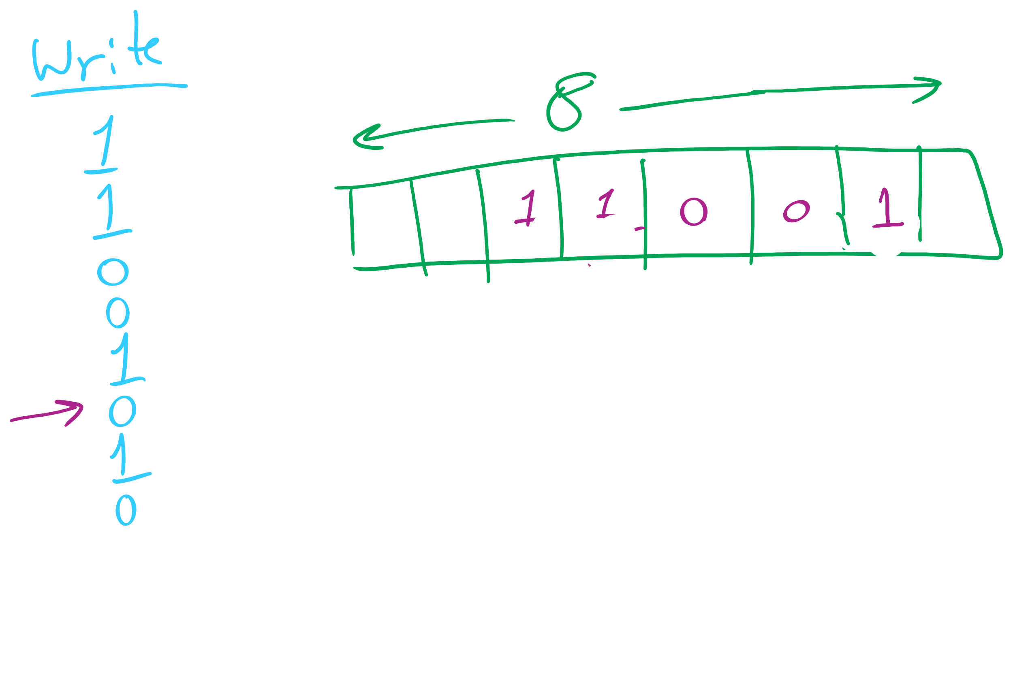
Binary I/O

Slide 46
Representing tries as bitstrings

Slide 47
Binary I/O
private static void writeTrie(Node x){
if (x.isLeaf()) {
BinaryStdOut.write(true);
BinaryStdOut.write(x.ch);
return;
}
BinaryStdOut.write(false);
writeTrie(x.left);
writeTrie(x.right);
}
private static Node readTrie() {
if (BinaryStdIn.readBoolean())
return new Node(BinaryStdIn.readChar(), 0, null, null);
return new Node('\0', 0, readTrie(), readTrie());
}
Notes:
tracing through to verify that this code works is left as an exercise to the students

Slide 48
Huffman pseudocode
Encoding approach:
Read input
Compute frequencies
Build trie/codeword table
Write out trie as a bitstring to compressed file
Write out character count of input
Use table to write out the codeword for each input character
Decoding approach:
Read trie
Read character count
Use trie to decode bitstring of compressed file

Slide 49
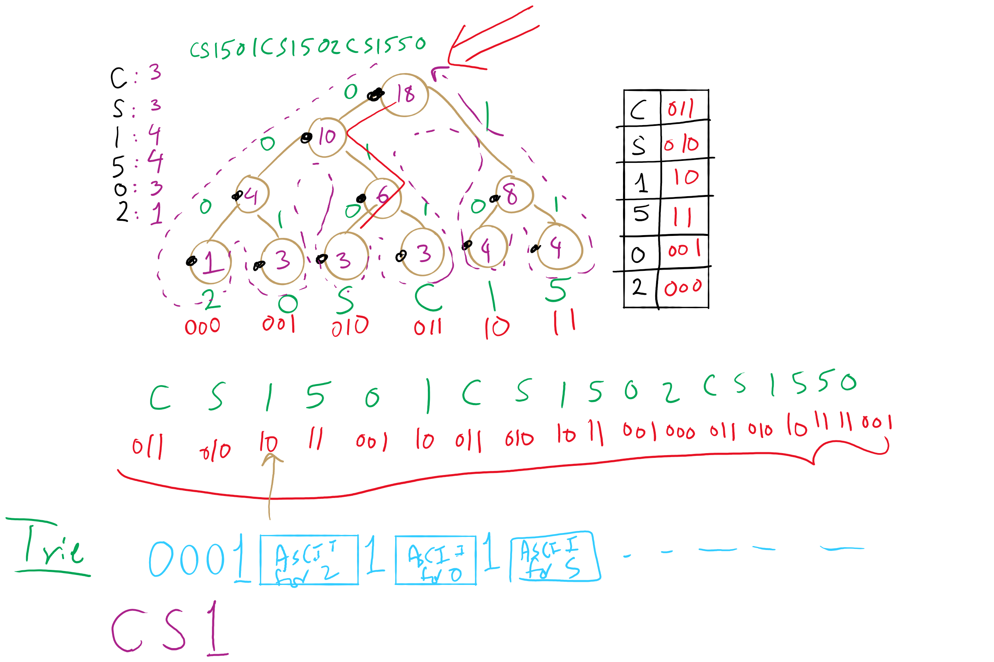
Huffman Compression Example

Slide 50
How do we determine character frequencies?
Option 1: Preprocess the file to be compressed
Upside: Ensure that Huffman’s algorithm will produce the best output for the given file
Downsides:
Requires two passes over the input, one to analyze frequencies/build the trie/build the code lookup table, and another to compress the file
Trie must be stored with the compressed file, reducing the quality of the compression
This especially hurts small files
Generally, large files are more amenable to Huffman compression
Just because a file is large, however, does not mean that it will compress well!

Slide 51
How do we determine character frequencies?
Option 2: Use a static trie
Analyze multiple sample files, build a single tree that will be used for all compressions/expansions
Saves on trie storage overhead…
But in general not a very good approach
Different character frequency characteristics of different files means that a code set/trie that works well for one file could work very poorly for another
Could even cause an increase in file size after “compression”!

Slide 52
How do we determine character frequencies?
Option 3: Adaptive Huffman coding
Single pass over the data to construct the codes and compress a file with no background knowledge of the source distribution
Not going to really focus on adaptive Huffman in the class, just pointing out that it exists...

Slide 53
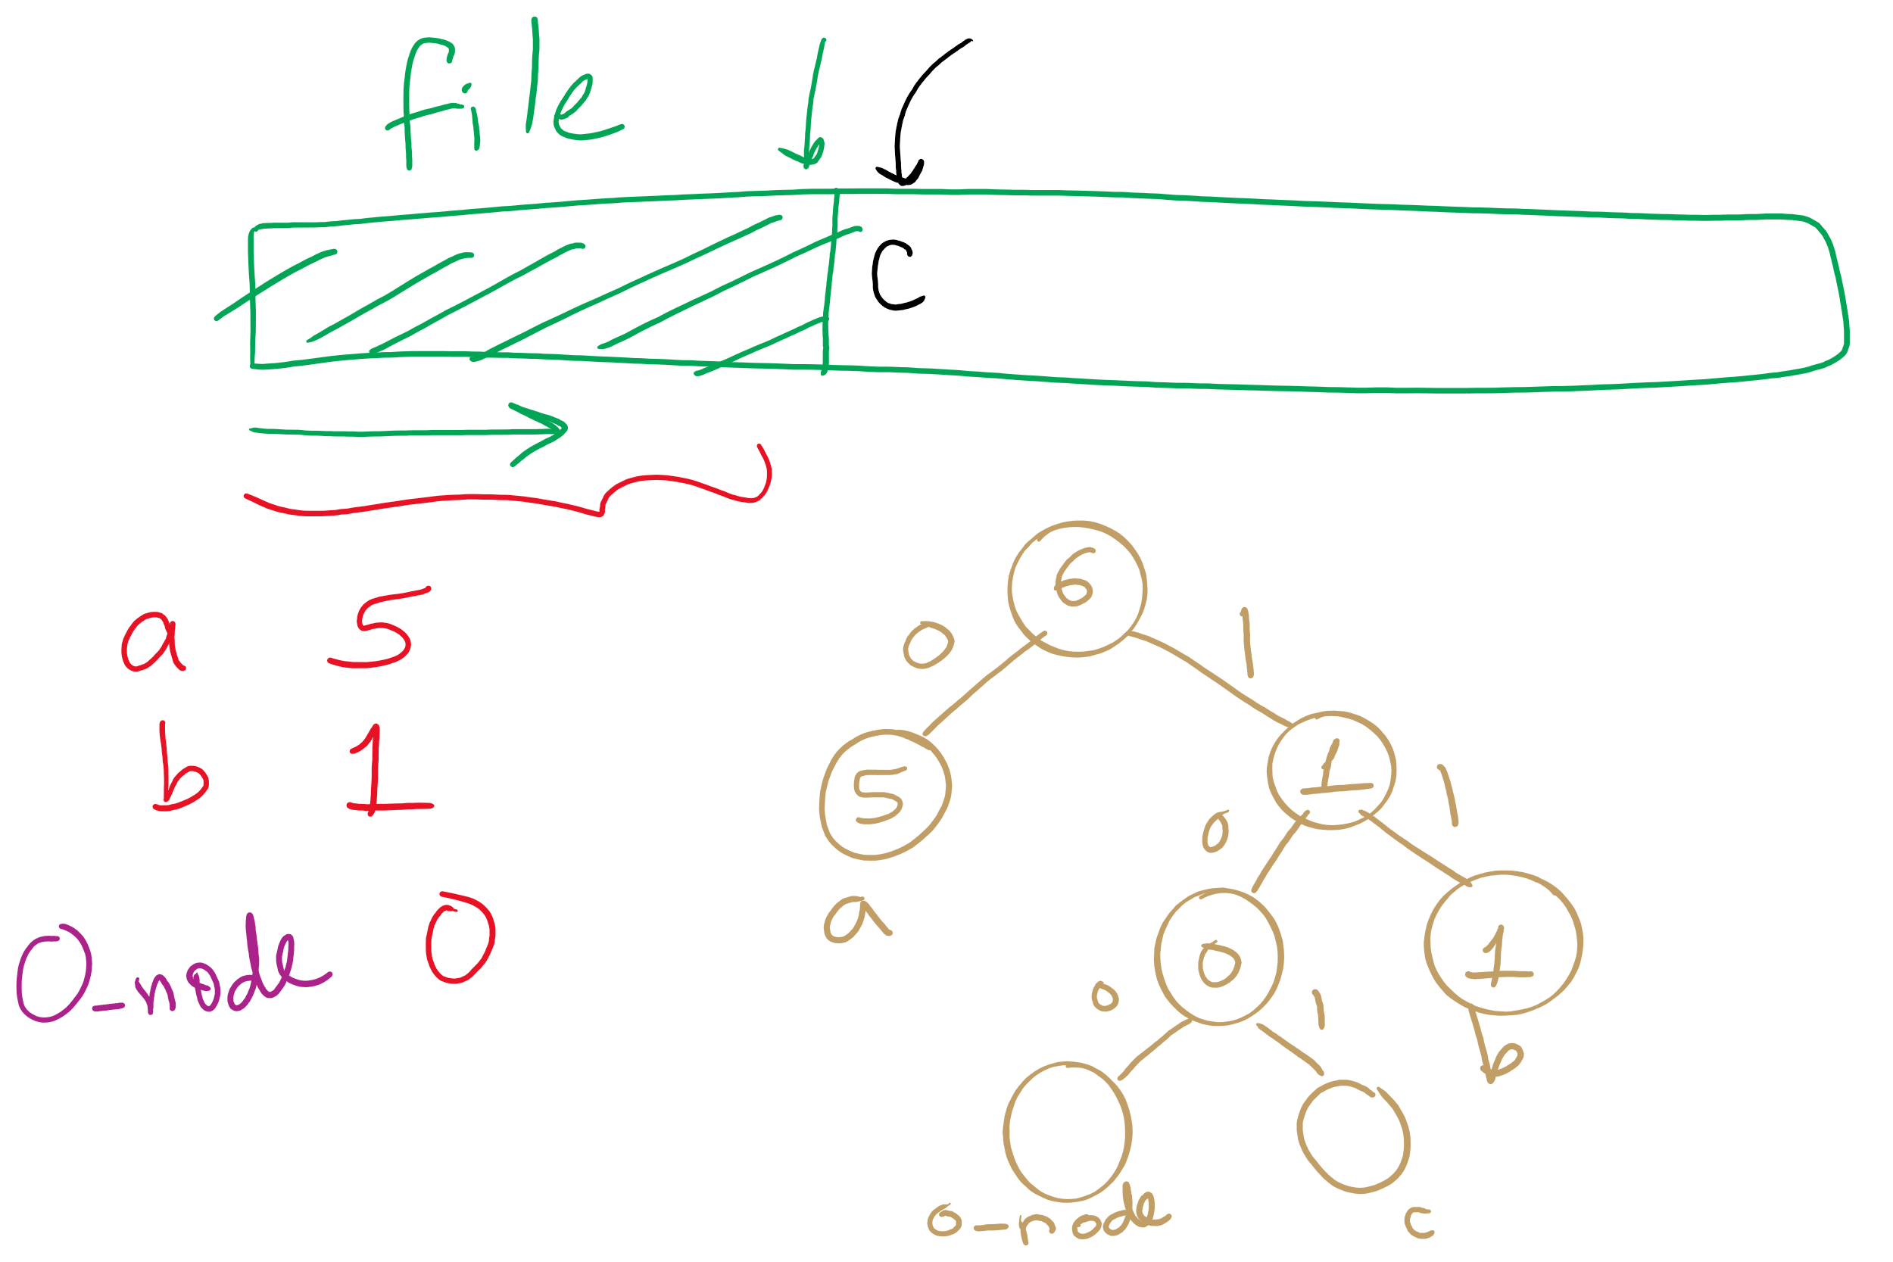
Adaptive Huffman

Slide 54
Ok, so how good is Huffman compression
ASCII requires 8m bits to store m characters
For a file containing c different characters
Given Huffman codes {h₀, h₁, h₂, …, h_{(c-1)}}
And frequencies {f₀, f₁, f₂, …, f_{(c-1)}}
Sum from 0 to c-1: |h_{i}|* f_{i}
Total storage depends on the differences in frequencies
The bigger the differences, the better the potential for compression
Huffman is optimal for character-by-character prefix-free encodings
Proof in Propositions T and U of Section 5.5 of the text

Slide 55
Please submit your reflections by using the CourseMIRROR App
If you are having a problem with CourseMIRROR, please send an email to coursemirror.development@gmail.com
Notes:
All right!
Upcoming Due Dates at A Glance

